Slide 1
Coursera Capstone Project IBM Applied Data Science Capstone Opening a New Shopping Mall in Kuala Lumpur, Malaysia
By: Arjun Thottappillil

Slide 2
Business Problem
Location is one of the most important factors that will determine whether the mall will be either a success or a failure
Objective: To analyze and then select the ideal locations in the city of Kuala Lumpur, Malaysia in which to build a new shopping mall
Business Question
In the city of Kuala Lumpur, Malaysia, where would be the best place for a property developer to open a new shopping mall?

Slide 3
Data
Data Required
List of neighborhoods in Kuala Lumpur, Malaysia
Latitude and Longitude coordinates of the neighborhoods
Venue data, particularly data related to shopping malls
Sources of Data
Wikipedia Page for neighborhoods (https://en.wikipedia.org/wiki/Category:Suburbs_in_Kuala_Lumpur)
Geocoder Package for finding Latitude and Longitude coordinates
Foursquare API for venue data

Slide 4
Methodology
Web scraping the Wikipedia page for list of neighborhoods
Retrieving Latitude and Longitude coordinates with Geocoder Package
Use Foursquare API to obtain venue data
Group data by neighborhood and then calculate the mean frequency of occurrence of each venue category
Filter venue categories to only include Shopping Mall
Perform Clustering on the data via the k-means clustering method
Visualize the clusters in a map using Folium

Slide 5
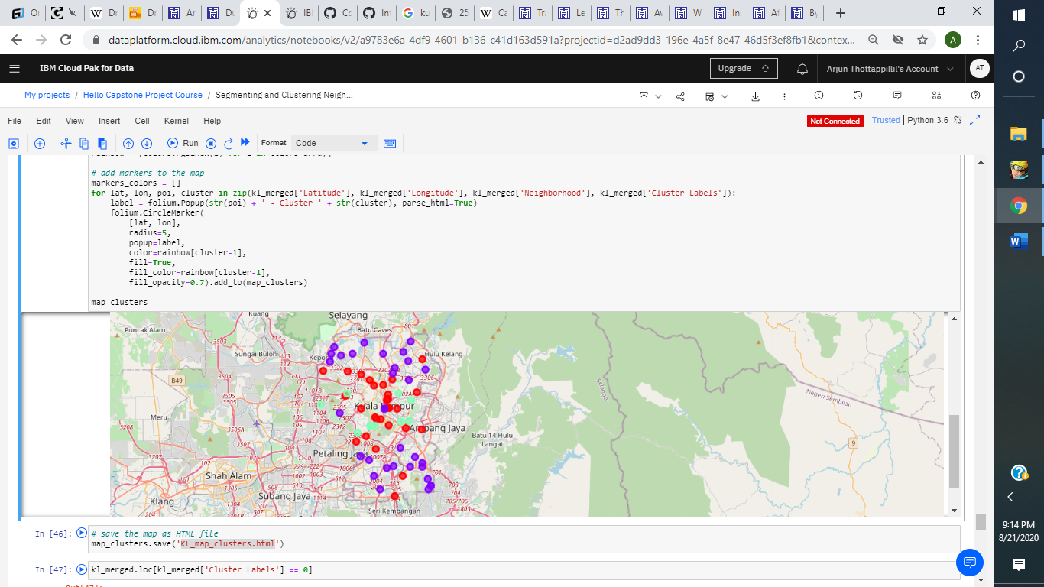
Results
Categorize the neighborhoods into 3 clusters:
Cluster 0: Neighborhoods with moderate number of shopping malls
Cluster 1: Neighborhoods with very few to zero shopping malls
Cluster 2: Neighborhoods with a high concentration of shopping malls

Slide 6
Discussion
Most of the shopping malls in Kuala Lumpur are mainly located in the central part of the city
Cluster 2 has the highest concentration of shopping malls and moderate number in cluster 0
cluster 1 has the lowest or zero shopping malls in the neighborhood
Oversupply and intense competition risk with the shopping malls in the central part of the city due to high concentration of shopping malls in the area, in the suburban part of the city are still relatively open to new shopping malls being open in the area

Slide 7
Recommendations
Open new shopping malls in neighborhoods in cluster 1 due to the low to non-existent competition in the area
Cluster 0 is also viable so long as the property developers have unique selling propositions that will allow them to stand out compared to their competitors
Avoid opening shopping malls in the neighborhoods in cluster 2, as they already have too high a concentration of shopping malls

Slide 8
Conclusion
Answer to the business question: The neighborhoods in cluster 1 are the best possible locations to open a new shopping mall in
The final findings of this project will hopefully assist the property developers and investors capitalize on the high potential locations while avoiding the overcrowded areas when they make their decision on where to open their new shopping mall

Slide 9
References
Category: Suburbs in Kuala Lumpur. Wikipedia. Retrieved from
https://en.wikipedia.org/wiki/Category:Suburbs_in_Kuala_Lumpur
Foursquare Developers Documentation. Foursquare. Retrieved from
https://developer.foursquare.com/docs/

